Slide 1
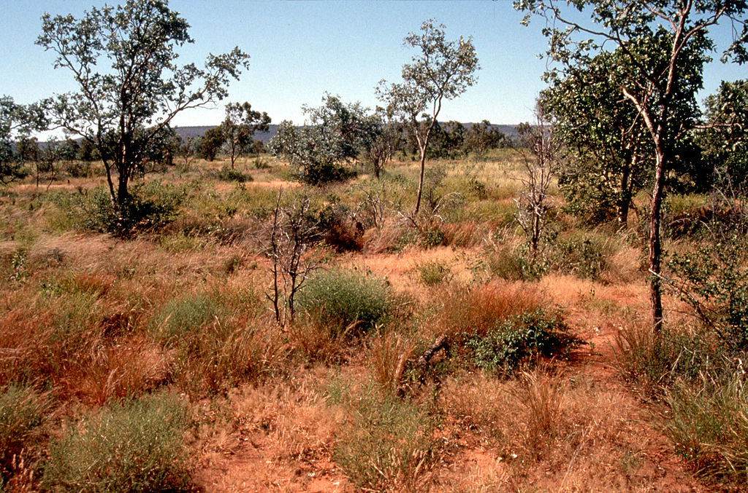
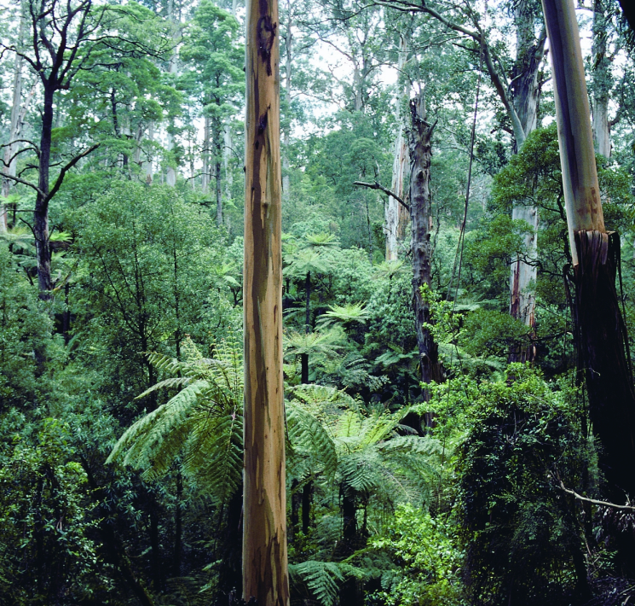

Discriminating secondary versus primary forest components of land use change fluxes using POP: a solution for Earth System models
CSIRO Oceans and atmosphere
Vanessa Haverd, Ben Smith, Lars Nieradzik,
Peter Briggs, Cathy Trudinger, Pep Canadell

Slide 2
Basic equation governing forest biomass development
Woody biomass
fraction of NPP
allocated to wood
turnover (1/yr)
of pool ‘y’
f_{w}
NPP
τ_{w}
Vary with stand structure, age and hence timing of LUC transition
Notes:
Turnover of biomass is as important as production (NPP) in describing dynamics of plant, litter and soil carbon pools. The turnover coefficient for woody biomass integrates multiple time-dependent mortality processes (stress, background, fire, storm), with differential effects on populations and individuals. Yet in earth system modelling, turnover of woody biomass is applied to a single “Big-Wood” pool.
NPP and turnover depend on physilogy and demography, and the timing of land-use transitions.

Slide 3
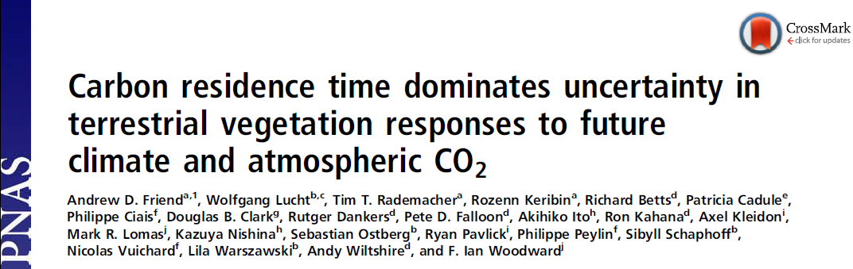
“Carbon residence time dominates uncertainty in terrestrial vegetation responses to future climate and atmospheric CO2”
Vegetation responses predicted by 7 GVMs to CMIP5 future climate projections
“A change in research priorities away from production and toward structural dynamics and demographic processes is recommended.”
Friend et al., 2014
PNAS, 111: 3280

Slide 4
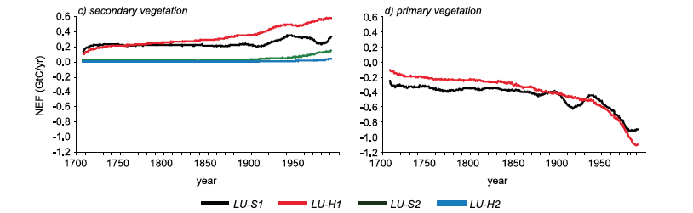
Importance of the Secondary Vegetation Sink
Secondary Forest Sink of 0.3-0.6 GT C y⁻¹ (1990s)
Shevliakova et al. 2009, GBC, 23

Slide 5
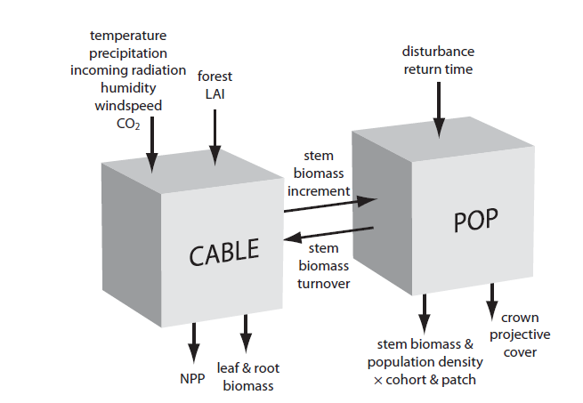
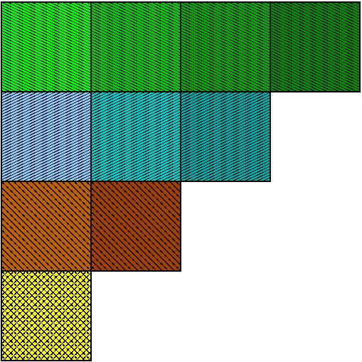
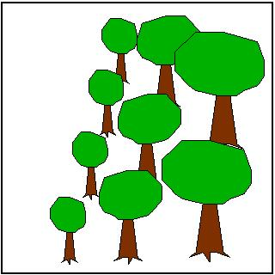
New approach: Populations-order-physiology (POP)
Grid-cells
patches (disturbance )
cohorts
(recruitment, growth, mortality)
*Haverd et al. 2013
Geophysical Research Letters 40: 5234-5239
Notes:
The essential coupling elements are transfer of stem biomass increment of host LSM to POP and transfer of biomass turnover rate from POP to host LSM.
Forcing by whole-ecosystem stem biomass increment (fixed fraction of NPP) from CABLE
Simulate recruitment, allometric growth and mortality of age-size cohorts of generic trees in local stands
Partition total stem biomass increment among stands and cohorts as a declining proportion of current size
Mortality influenced by declining growth efficiency under crowding and with increased size
Upscaling to landscape (grid cell) by interpolation among stands of different age-since-disturbance
Two disturbance types:
catastrophic (e.g. cyclone), fixed longish return time (200 yr)
partial (wildfire), variable return time (1-10 yr)

Slide 6
POP: Scaling up from the patch to the land-scape
Poisson distribution with parameter λ
probability density
λ= mean disturbance frequency (yr⁻¹)
Negative exponential distribution with parameter 1/λ
weight w_{i} for patch
of age a_{i}
Example:
landscape level stem biomass:
probability density
1/λ
a_{i}
patch age (yr)
total stem biomass for patch
Notes:
In a primary forest: disturbance is considered a Poisson process, leading to a negative exponential distribution of patch ages in the landscape. The weighting for each age class is determined by interpolation of the distribution, and landscape-scale biomass and turnover are the weighted sum over all age classes.

Slide 7
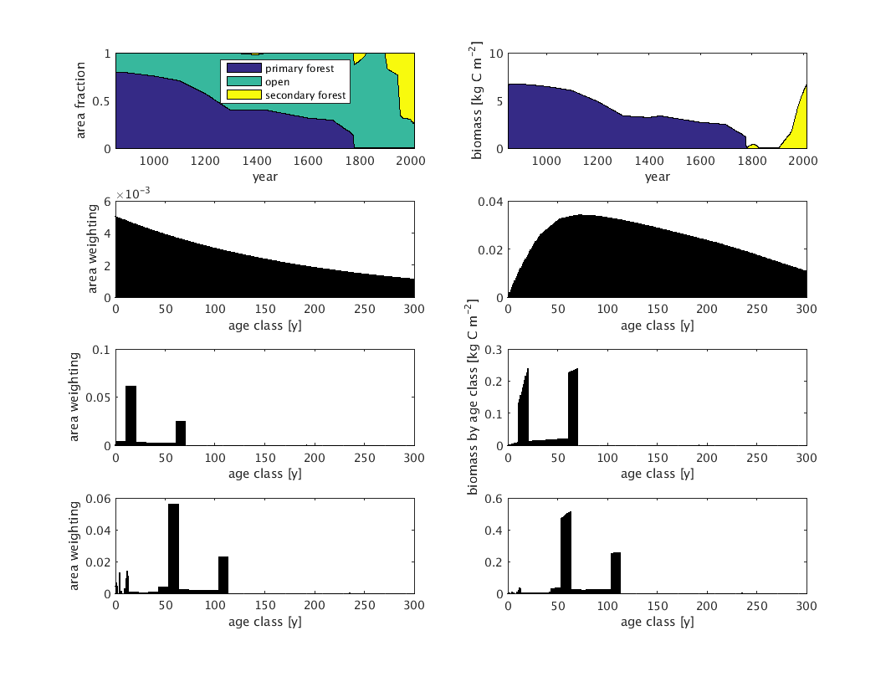
Interaction of Land Use Module with POP
LAND USE MODULE
Land-use transition matrix
wood harvest data
Area weights for each forest age class
PFT Area Fractions
Carbon Redistribution
Primary
CABLE
Secondary

Slide 8
LUH2 sets
Transitions; Harvest; Secondary Forest age distribution
LUH2 sets gridcells for land use
LUH2 Climate Info
Potential veg type
Temperature to distinguish C3/C4, crop or grass
LAND USE CHANGE
LUH2
SPIN TIME
RUN TIME
Primary “Forest”
(1)
Secondary “Forest”
(0)
Primary “Forest”
(1)
Secondary “Forest”
(0)
Primary “Forest”
(0..1)
Secondary “Forest”
(0..1)
HARV
HARV
iveg_{p}
iveg_{p}
Crop
(0)
Grass
(0)
Crop
(0)
Grass
(0)
Crop
(0..1)
Grass
(0..1)
HARV
iveg_{crop}
iveg_{grass}
Initialisation
Spinup
Run

Slide 9
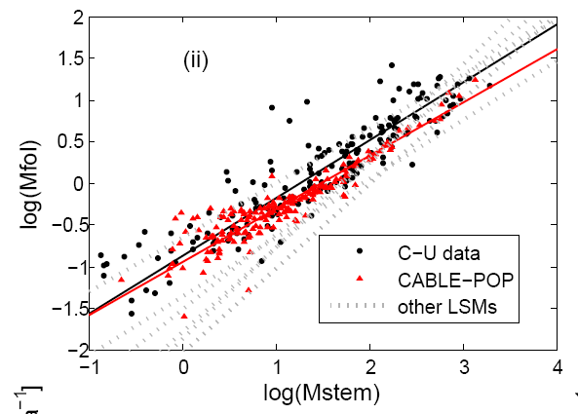
CABLE-POP reproduces observation-based leaf-stem allometry relation*
“Function”
Curve fits for
other LSMs:
Wolf et al. 2011
Global Biogeochem
Cycles 25
“Structure”
Relationship emerges because of known demographic effects on productivity and turnover
*Haverd et al., 2014 Biogeosciences 11: 4039-4055
Notes:
Structure-function relation: emerges
Ecological defensible way, based on known physilogy and demography

Slide 10
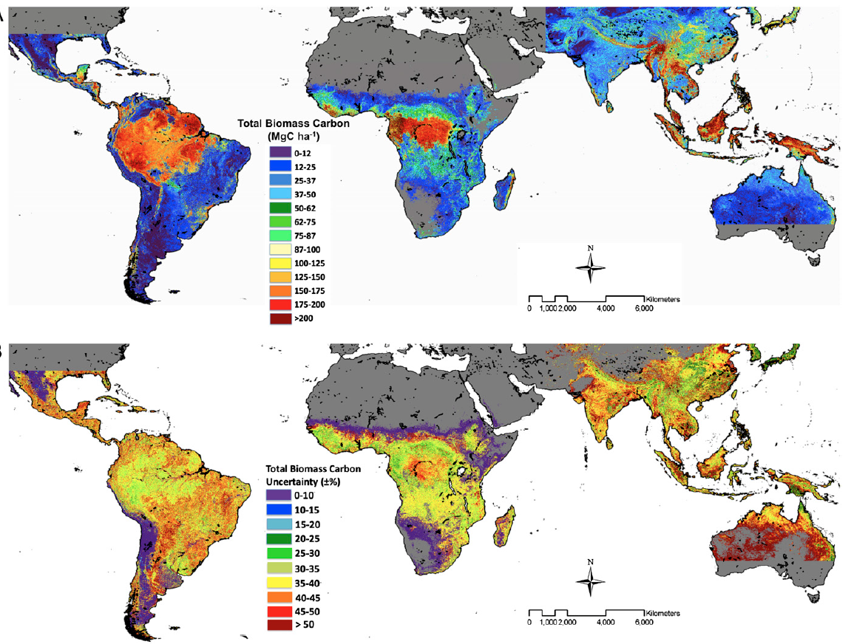
Saatchi et al., 2011, PNAS, 108

Slide 11
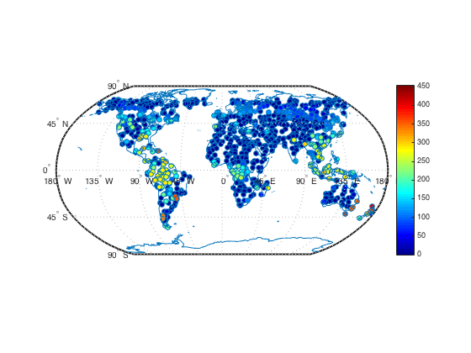
Global Biomass: CABLE-POP
tC ha⁻¹

Slide 12
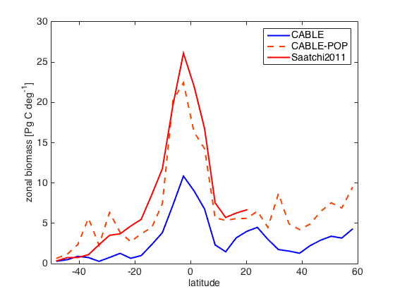
Global Biomass: CABLE, CABL-POP and Saatchi benchmark

Slide 13
Example: Land Use Change in Poland (52.75N, 23.75E) (LUH2 land use transition data)
area
biomass
Area Fraction
Biomass [kg C m⁻²]
1200
1200
Notes:
Two cohorts: flush of secondary forests
Pre-industrial and post_industrial afforestation. (Event A and Event B)
Event B: young trees accumulating biomass
Event A: close to carrying capacity
Effect of time and age on NPP
If you want to get the carbon fluxes right, you need to have the age-dependence of NPP and turnover.

Slide 14
Example: Land Use Change in Poland (52.75N, 23.75E) (LUH2 land use transition data)
area
biomass
A
B
B
A
Area Fraction
Biomass [kg C m⁻²]
B
B
A
A
1970
1970
Notes:
Two cohorts: flush of secondary forests
Pre-industrial and post_industrial afforestation. (Event A and Event B)
Event B: young trees accumulating biomass
Event A: close to carrying capacity
Effect of time and age on NPP
If you want to get the carbon fluxes right, you need to have the age-dependence of NPP and turnover.

Slide 15
Example: Land Use Change in Poland (52.75N, 23.75E) (LUH2 land use transition data)
area
biomass
A
B
B
A
Area Fraction
Biomass [kg C m⁻²]
B
B
B
A
A
A
2013
2013
2013
Biomass accessible for harvest related to age class
Notes:
Two cohorts: flush of secondary forests
Pre-industrial and post_industrial afforestation. (Event A and Event B)
Event B: young trees accumulating biomass
Event A: close to carrying capacity
Effect of time and age on NPP
If you want to get the carbon fluxes right, you need to have the age-dependence of NPP and turnover.

Slide 16
New CABLE Developments Incoporated in Global Simulations for PLUME-MIP
Haverd2013 Drought Response function and effect of leaf litter on soil evaporation. (Haverd et al. GMDD 2016)
Climate-driven phenology (Sykes et al. J. Biogeog. 1996)
Potential Vegetation type driven by climate (not for PLUME) (Prentice et al., J. Biogeog, 1992)
Variable turnover of Biomass (from POP)
Allocation to leaves and stems constrained by “Pipe Model” (uses sapwood area POP).
Stem Autotrophic respiration modified by fraction sapwood (from POP)
Leaf respiration modified by photo-inhibition (Brooks and Farquhar, Planta, 1985) and temperature acclimation response. (Atkins et al., New Phyt., 2015)
Carbon conservation problem addressed.

Slide 17
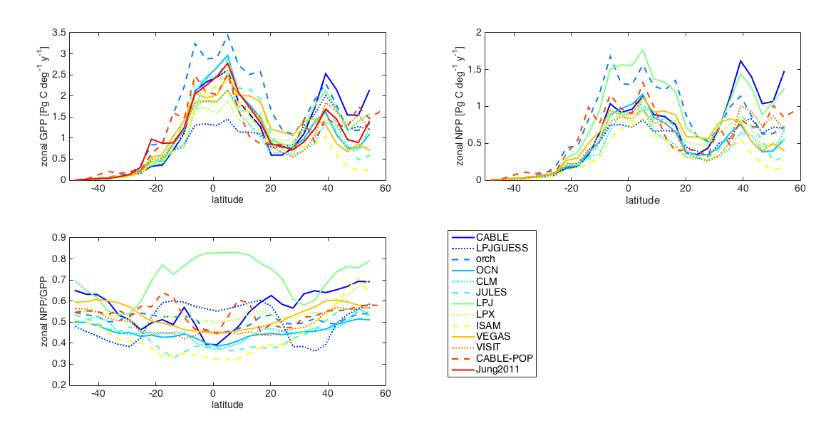
Latitudinal profiles of GPP, NPP and Carbon Use Effciency: TRENDY, CABLE-POP and Upscaled Flux Data

Slide 18
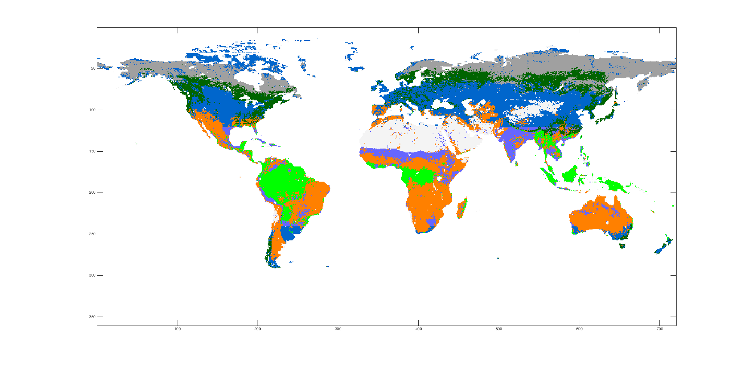
Land Cover Classes for Biome Aggregation
Barren
Lowlatshrubby
Highlatshrubby
Trropical Grass
Extra-Tropical Grass
Tropical Forest
Extra Tropical Forest

Slide 19
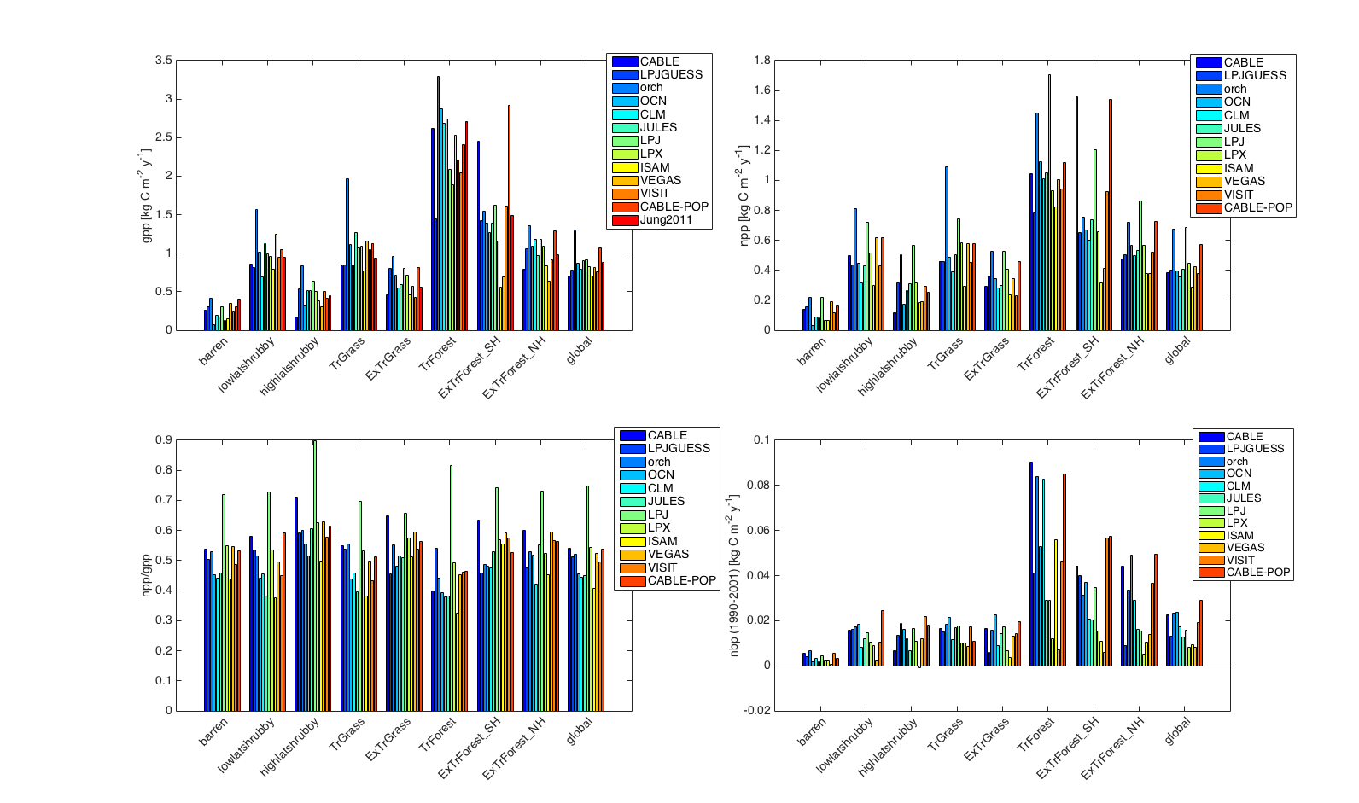
GPP by Biome: TRENDY, CABLE-POP and Upscaled Flux Data

Slide 20
NPP by Biome: TRENDY and CABLE-POP

Slide 21
Carbon Use Efficiency by Biome: TRENDY and CABLE-POP

Slide 22
NBP by biome: TRENDY and CABLE-POP

Slide 23
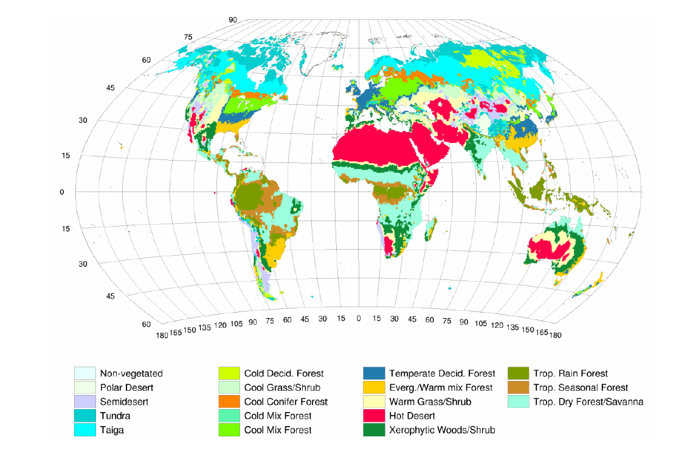
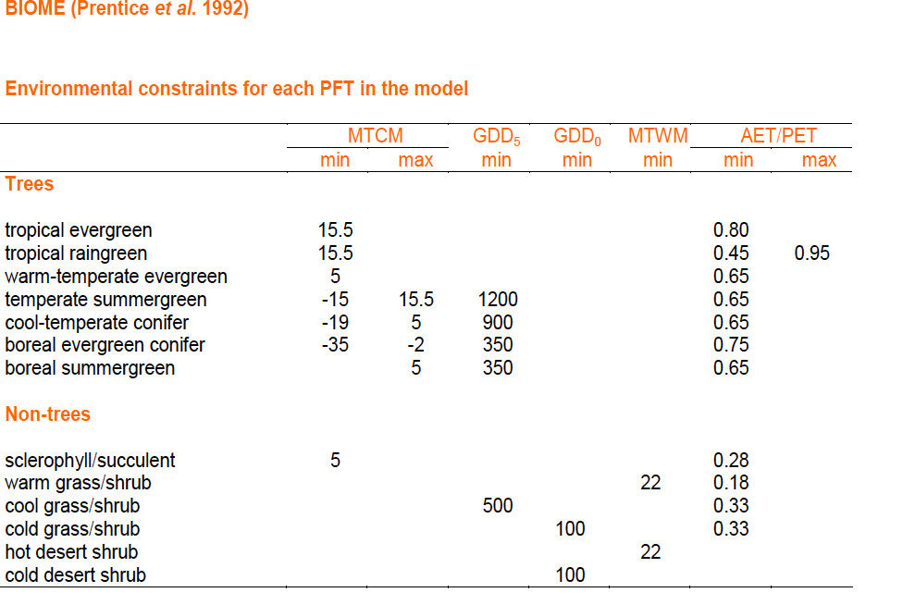
BIOME1: Climatic Envelope model for PFTs

Slide 24
Summary POP represents different elements of the landscape as explicit stands distinguished by age. Land use transition matrix is used to drive changes in the aerial coverage of those elements. By representing biomass development of individual forest stands, rather than the whole landscape, we trivially account for different carbon exchange behaviour of primary and secondary forests.

Slide 25
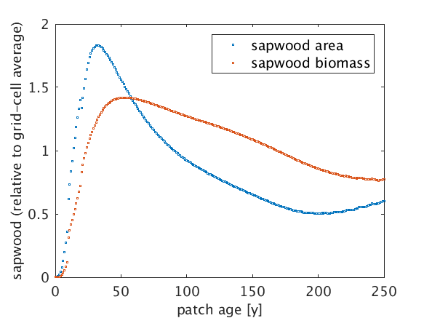
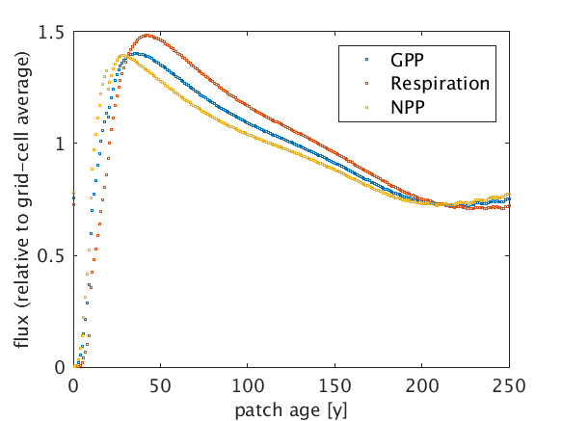
Age effects on Net Primary Production in POP
structure
function
proportional to leaf area
Notes:
Sapwood is basically a set of pipes to conduct water from roots to leaves. Inititally, sapwood area increases as trees colonise the available space. As the trees grow, sapwood biomass increases because trees are getting taller, leading to higher costs to maintain sapwood area. Therefore trees have to sacrifice some pipes to keep their C-budget in balance. This reduces SA, while sapwood biomass reaches its peak when mortality catches up with height growth.
SA affects GPP via its proportionality with LA, while sapwood biomass affects tree respiration. This leads to age dependences of GPP, Respiration and ultimately NPP.

